Slide 1
Insecta
The Most Child Friendly Tower Defence Game

Slide 2
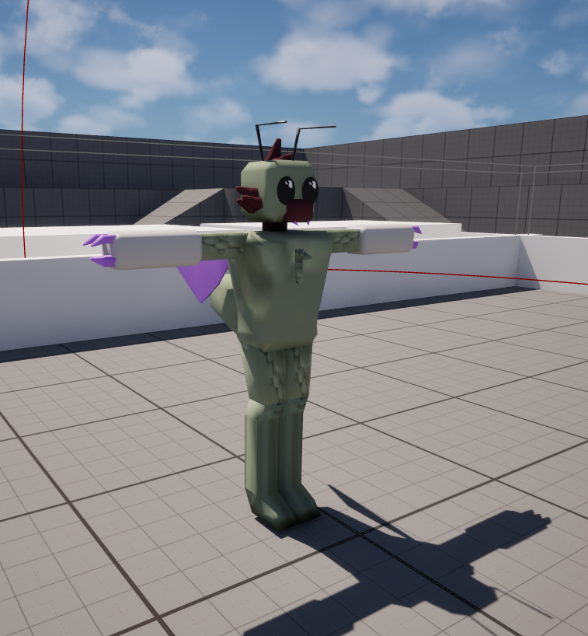
How we meet the requirements?
Our game Insecta excellently meets requirements by using a limited number of colours, in fact we majority only use two colours white & grey. if you’re seeking out a game with a limited colour palette you won’t come across as many as limited as ours. This internally imposed restrictiveness was designed with children in mind knowing that lot’s of colours can be used to confuse them. There are countless deceptive games on the app store which use bright colours to attract attention of children, we are not one of them.

Slide 3
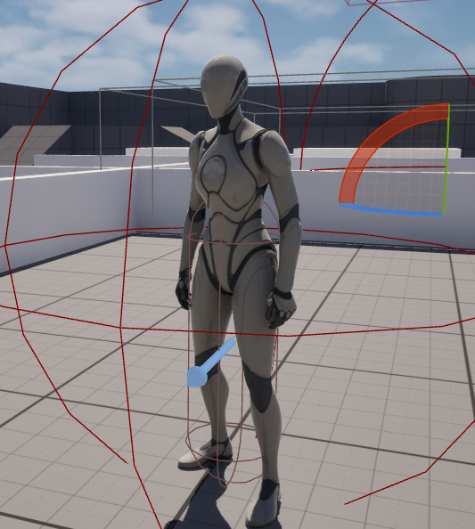
How we meet the requirements? (UI / Wave)
UI was an essential part of the game, it’s a main focus of the game, you can’t avoid and you wouldn’t want to, as the game feels like it works best when using it.
The wave theme was our most creative implementation, waves of enemies spawn filling the screen. We decided in our idea generating that we wanted to avoid the obvious beach and seaside/water themes and do something creative. This idea generating spawned the tower defence game, waves = waves of enemies.

Slide 4
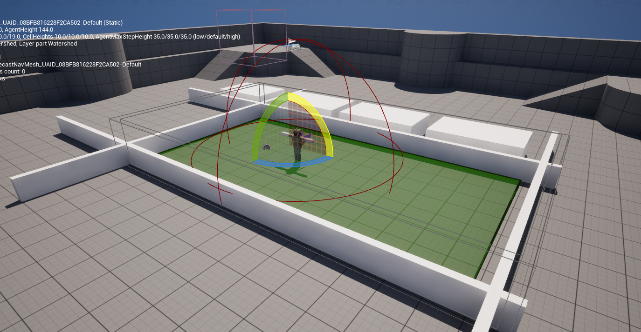
Image in edit mode

Slide 5

How is our game appropriate? (Design)
Of course when making the game the target audience of pegi 3+ was of paramount importance. Parents will find our game to be completely devoid of inappropriate themes and features. We are proud of how much we have prioritised child safety the game is easy to understand with no confusing elements that could cause the child harm. A similar games that does this is BTD 6.

Slide 6
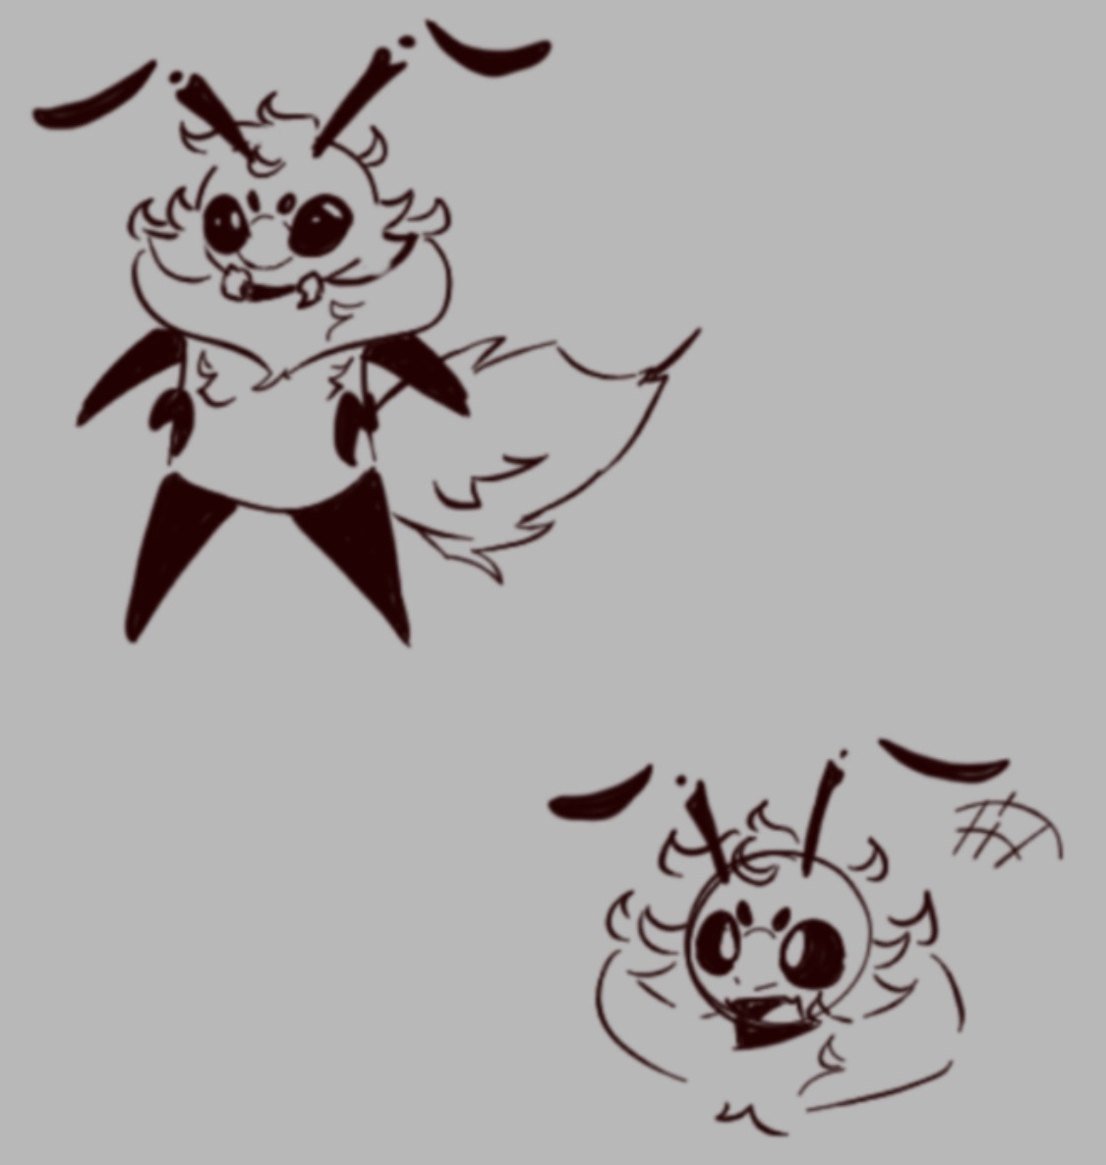
How is our game appropriate? (Art)
The insects in our game are too detailed to ensure they aren’t frightening to little children. As was our goal from the beginning we wanted to deliver a game about bugs, which showed the friendlier and less appreciated, less threatening side to earth's misunderstood critters.

Slide 7
How We Did The Code?
For the coding side of this project we focused on bug free smooth code that limits lag so it can run well on all machines. We used

Slide 8
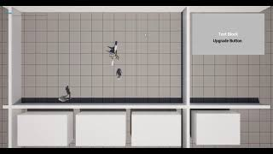
Video Example

